Slide 1
CHAPTER 4
LINKED LIST

Slide 2
Linked List outline
Why linked lists
Linked lists
Representation of Linked lists in memory
Traversing a linked lists
Memory allocation: Garbage collection
Overflow and Underflow
Basic operations of linked lists
  Insert, find, delete, print, etc.
Variations of linked lists
  Circular linked lists
  Doubly linked lists

Slide 3
Why linked lists
Disadvantages of arrays as storage data structures:
  slow insertion in ordered array
  Fixed size
Linked lists solve some of these problems
Linked lists are general purpose storage data structures.

Slide 4
Definition
It is a list or collection of data items that can be stored in scattered locations (positions) in memory by establishing link between the items.
To store data in scattered locations in memory we have to make link between one data item to another.
So, each data item or element must have two parts: one is data part and another is link (pointer) part.

Slide 5
Definition [cont..]
Each data item of a linked list is called a node. Data part contains (holds) actual data (information) and the link part points to the next node of the list.
To locate the list an external pointer is used that points the first node of the list.
The link part of the last node will not point any node. That means it will be null.
This type of list is called linear (one way) linked list or simply linked list.

Slide 6
A single node of linked list
A node can be declared/define using code as follows:
struct node
{
int data;
node *next;
}
Data part
Pointer part
Fig: 4.1 Graphical representation of a node
Variable for data part
Variable for pointer part
(A pointer that will point next node)

Slide 7
Graphical Representation
Linked list:
List
External Pointer
Last node does not point any node, therefore it is NULL
70
80
90
95
100
Pointer that points the next node
Figure 4.2: Graphical representation of a linear linked list

Slide 8
Storing data in a node
1. Node declaration:
struct node
{
int data;
node *next;
}
2. Storing data: nptr
node *nptr; // declara a pointer variable
nptr= new(node); // allocate space (memory)
nptr->data= 20; // insert data to data part
nptr->next = NULL; // assign NULL to pointer part
20

Slide 9
Create a new node
1. Node declaration:
struct node
{
int data;
node *next;
};
2. Declare variable (pointer type) that point to the node:
node *nptr;
3. Allocate memory for new node:
nptr = new (node);
4. Enter value:
nptr→data = item; //item is a variable
nptr→next = NULL;

Slide 10
A Linked List Creation Process
1. Create an empty linked list.
  (That means, the external pointer will be null. )
2. Create a new node.
(The data part of the new node will contain data (information) and the pointer part will contain null. )
3. The external pointer will point the new node.
( At this point only one node in the list.)
4. Create another new node and include the node to the linked list.
5. Repeat the process to include any other node.
(Thus we can create a linked list.)

Slide 11
Linked List Creation Process
Create an empty list, the pointer list will point to Null
list = NULL; list
2) Create a new node with data
nptr = new (node);
nptr ->data = 40;
nptr -> next = NULL; nptr
3) Include the node to the list
list
list = nptr;
tprt= nptr;
tptr
Here tptr is temporary pointer used to make link between existing list and new node.
40
40

Slide 12
Linked List Creation Process (New Node Inclusion)
Create a new node with data
nptr = new (node);
nptr ->data = 48;
nptr -> next = NULL;
list
tptr nptr
tptr ->next = nptr;
tptr = nptr;
40
48
1st node pointer
2nd node pointer
Update tprt
Here tptr is temporary pointer used to make link between existing list and new node.
Notes:
Create a new node with data
nptr = new (node);
nptr ->data = 40;
nptr -> next = NULL;
Include the node to the list
list = nptr;
tprt= nptr;

Slide 13
Addition of node to a linked list (Graphical view)
We shall enter data in ascending order and create the list.
Figure 4.2: A pictorial view of addition of items to a linked list
1.
List
40
48
tptr→next = nptr;
tptr
59
2.
List
nptr
40
48
59
tptr = nptr;
tptr
nptr
Notes:
Create a new node with data
nptr = new (node);
nptr ->data = 59;
nptr -> next = NULL;
tptr ->next = nptr;
tptr = nptr;

Slide 14
Algorithm to create a linked list (pseudocode)
1. Declare node and pointers :
struct node
{
int data;
node *next;
};
node *list, *tptr, *nptr;
2. Create an empty list:
list = NULL;
3. Create a new node:
nptr = new (node);
nptr→data = item;
nptr→next = NULL;
4. Make link between the linked
list and the new node:
if (list = = NULL)
{
list = nptr;
tptr = nptr;
}
else
{
tptr→next = nptr;
tptr = nptr;
}
5. Repeat Step 3 and 4 necessary
times to add more nodes.
6. Output linked list.
Notes:
At the beginning nptr was the memory location of the First Node. Then the it was assigned to list(pointer), which means list contains the memory location of the first node.
(tptr→next = nptr;) tptr->next is from the previous node. After assigning the new current node(nptr) to tprt->next the tprt is updated by moving it to the current node through assigning the tptr = nptr

Slide 15
Program to create a linked list
void main()
{
struct node
{
int data;
node *next;
};
int i,n,item;
node *nptr, *tptr, *list; // Necessary pointers
list=NULL; // Create an empty list
cout<<"Enter number of nodes:";
cin>>n;

Slide 16
Program [Cont..]
cout<<"Enter data for node with space:";
for (i=1;i<=n;++i)
{
cin>>item;
nptr=new (node); // node *nptr
nptr->data=item;
nptr->next=NULL;
if (list==NULL) //List is empty
{
list=nptr; //Include first node
tptr=nptr; // temporary pointer
}
//There is/are node(s)
else
{
tptr->next=nptr;
tptr=nptr;
}
} // end of for loop
// address of current/successive node assigned to the next part of preceding node
Notes:
At the beginning nptr was the memory location of the First Node. Then the it was assigned to list(pointer), which means list contains the memory location of the first node.
(tptr→next = nptr;) tptr->next is from the previous node. After assigning the new current node(nptr) to tprt->next the tprt is updated by moving it to the current node through assigning the tptr = nptr

Slide 17
Program [Cont..]
//Display data
tptr=list;
for (i=1; i<=n;++i)
{
cout<<endl;
cout<<tptr->data; // print the value of the first node
tptr=tptr->next; // move to the next node
cout<< " ";
}
cout<<endl;
cout<<endl;
}

Slide 18
Search or Locate a node of a linked list
Given a linked list, we have to find out a node whose value is known such as 51.
List
20
45
51
84

Slide 19
Locate or Search a node
Problem 5.1:Find out the item 51 from above
linked list. All items in the list were stored in
ascending order.
To locate the node we have to traverse the list
using a pointer.
a) We have to use a temporary pointer to traverse the list.
b) At each node we shall compare and check whether we have found the node or not.

Slide 20
Locate a node of a linked list (Graphical view)
list
20
45
51
84
tptr->data = 51 ?
tptr
list
20
45
51
84
tptr
tptr=tptr->next;

Slide 21

Algorithm to search a node from a linked list (pseudocode)
  1. Define a variable (item) and a pointer (tptr)
  2. Input the value to be located:
  item = 51;
  3. Search the item:
  tptr = list;
  while (tptr->data !=item and tptr->next != NULL)
  {
  tptr = tptr→next; // move to the next node
  }
  4. Output:
  if (tptr→data == item);
  print “FOUND”
  else print “NOT FOUND”

Slide 22
Insert a node into a list
Here, we shall consider insertion of a node after the first
node or before the last node and the data of the list are
arranged in Ascending Order.
Here we have to perform two major tasks:
Locate (find out) the node after which the new node will be inserted.
2. Insert the node by making link.

Slide 23
Locate the position to insert (Graphical view)
List
40
48
59
63
55
(a) An existing Linked list
nptr
(b) A new Node
Appropriate position for new node
List
40
48
59
63
tptr
55
nptr
  (c) Finding out appropriate position for the new node

Slide 24
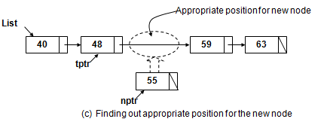
Locate the proper position for insertion
The steps to locate the position:
1. Assign the value of external pointer to a
temporary pointer (tptr = list).
2. Compare the value of the next node with the value of the new node.
3. Traverse the temporary pointer until we find
a greater node value than the value of the
new node
    tptr = tptr->next.

Slide 25
Locate the position to insert (Graphical view revisit)
List
40
48
59
63
55
(a) An existing Linked list
nptr
(b) A new Node
Appropriate position for new node
List
40
48
59
63
tptr
55
nptr
  (c) Finding out appropriate position for the new node

Slide 26
Node insertion in between two nodes
Insert the node by making link. The steps are:
1. Point the next node by the new node.
(nptr->next = tptr->next).
2. Point the new node by the previous node.
(tptr->next = nptr).
3. We have got an updated linked list.
48
59
2
1
tprt
55
nptr

Slide 27
Insert the node into a list (Graphical view)
List
40
48
59
63
tptr
55
nptr
  (d) Making link between the new node and the node after the tptr.
List
40
48
59
63
tptr
55
nptr
  (e) Making link between tptr and the new node
List
40
48
55
59
63
(f): Updated List

Slide 28
Algorithm to insert a node into a linked list (pseodocode)
Here, we shall consider insertion after the first node or before the last node.
  1. Input linked list (we have to use an existing list)
  2. Declare pointers (list, tptr, nptr)
  3. Create a new node:
  nptr = new (node);
  nptr→data = item;
  nptr→next = NULL;
  4. Locate the appropriate position for the new node
  while (tptr→data < nptr→data)
  {
  tpptr= tptr;
  tptr = tptr→next;
  }
  5. Insert the new node at appropriate position (by linking previous and next node);
  nptr→next = tpptr→next;
  tpptr→next = nptr;
  6. Output :updated
  linked list
(tptr = list).

Slide 29
Delete a node from a linked list
To delete a particular node from a linked list,
Three major tasks to be performed.
Find out or search the node to be deleted.
Establish the necessary link.
Delete the node.

Slide 30
Locate the node to be deleted
The steps to locate the node:
Use a temporary pointer and assign it the value of the external node (tprt= list).
Compare the value of the node pointed by the temporary pointer and the value of the node to be deleted.
If the first node is the target node, then we found the node. Otherwise,
Assign the value of the temporary pointer to another pointer or save the value (pptr=tptr).
Traverse the temporary node until we locate or find the node (tptr = tptr->next).

Slide 31
Establishing link before deletion
Making link between the nodes. The steps are:
The previous node will point the next node of the node to be deleted (pptr->next = tptr->next).
Delete the node.

Slide 32
Deletion of a particular node
(Graphical view)
List
40
48
55
59
63
(a) An existing Linked list
Node that is to be deleted
List
40
48
55
59
63
pptr
tptr
(b) Searching the target element
  1. making link between previous and next node of the node to be deleted
List
40
48
55
59
63
pptr
tptr
  2. deleting the target node
(c) Deleting the target node
List
40
48
59
63
(d) Updated List

Slide 33
Algorithm to delete a node from a linked list (pseudocode).
Here we shall not consider the deletion process of the first node and the last
node of the list.
1.Declare pointers (list, tptr, pptr)
2. Input linked list and the item (that is to be deleted)
3. Search the item to be deleted in the list:
tptr = list;
while (tptr→data != item)
{pptr = tptr;
tptr = tptr→next; }
4. Delete the node:
[Make link between previous and next node of the node that is
to be deleted and delete the target node]
pptr→next = tptr→next;
delete (tptr);
5. Output: updated linked lists

Slide 34
DOUBLY LINKED LIST
OR
TWO WAY LINKED LIST

Slide 35
Doubly Linked List
Definition:
A doubly or two way linked list is a list where each node has three parts.
  One is link or pointer to the previous (backward) node and
  One is data part to hold the data and
  Another is link or pointer to the following (forward) node.
    There is an external pointer to the first node of the list. It is also called two-way linked list.

Slide 36
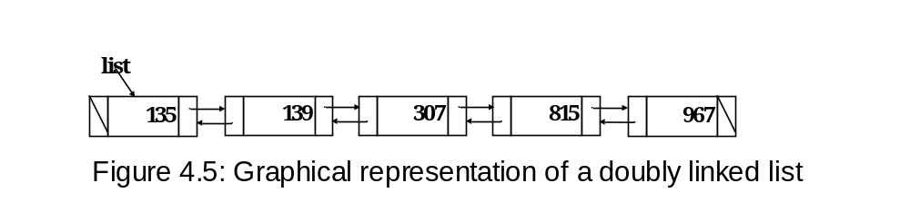
Doubly Linked List (Graphical representation)

Slide 37
A node of doubly linked list
back pointer forward pointer
Node declaration:
struct node:
{
node *back; //back pointer
int data;
node *next; //forward pointer
}
Data part

Slide 38
Create a node (pseudocode)
1. Declare a node:
struct node
{
node *back;
int data;
node *next;
};
2. Create a node:
node *nptr;
nptr = new (node);
nptr→back = NULL;
nptr→data = item; // item is a variable
nptr→next = NULL;

Slide 39
Creation Process of a Doubly Linked List
1. Create empty linked list (list =NULL).
2. Create a new node with data (see slide# 33).
3. Include the node to the list by making link.
4. Create another new node with data and include the node to the list.
5. Repeate the process.

Slide 40
Include a new node to the list
  The steps to include a new node to a doubly linked list:
  1.The next pointer of the last node will point the new node (tptr->next = nptr).
  2.The back pointer of the new node will point the last node of the list (nptr->back = tptr).

Slide 41
Create a Doubly linked list (Graphical view)
list
new node
125
596
256
nptr
tptr
(a) A doubly linked list and new node
next pointer of last node
back pointer of new node
list
1
125
596
256
2
tptr
tptr
nptr
(b) Linking new node and the last node of the list
list
125
596
256
tptr
(c) Doubly linked list after making list
Figure 4.6: Creation of doubly linked list (Pictorial View

Slide 42
Algorithm to create a doubly linked list (pseudocode)
1. Declare node and pointers:
a. struct node
{
node *back;
int data;
node *next;
}
b. node *list, *tptr;
2. Create an empty list:
list = NULL;
3. Create a new node:
node *nptr;
nptr = new (node);
nptr→back = NULL;
nptr→data = item;
nptr→next = NULL;
4. Make link between the last node of the
list and the new node:
if (list = NULL)
{
list = nptr;
tptr = nptr;
}
else
{
tptr→next = nptr;
nptr→back = tptr;
tptr = nptr;
}
5. Repeat step 3 and step 4 necessary
times.
6.Output a doubly linked list.

Slide 43
Insert a node into a doubly linked list
To Insert a node into a linked list we have to perform two major tasks:
Search or locate the proper position in the list where we have to insert the node.
Establish the link between the new node and existing nodes.

Slide 44
Node insertion [Contin..]
The steps to search the proper position for insertion:
1. Use temporary pointer (tptr) to find the position.
2. Start from the first node of the list (tptr = list).
3. Compare the data of the new node with the data of the next node to the temporary pointer.
4. If the data of the next node is greater, then we have found the position. Otherwise,
5. Traverse the temporary pointer (tprt = tptr->next).
6. Repeat the step 4 to step 6 until we find the position.

Slide 45
Node Insertion (Cont..]
Making link in case of insertion of new node in between two nodes:
The following are the steps to establish link:
Make link from the new node to the next node (of the new node’s position).
Make link from the next node to the new node.
Make link from the new node to the previous node (of the new node’s position).
Make link from the previous node to the new nodeh
180
310
4
2
256
1
3

Slide 46
Node Insertion (Cont..]
Making link in case of insertion of new node in between two nodes:
tptr
nptr
The following are the codes to establish link:
nptr ->next = tptr ->next;
tptr ->next ->back = nptr;
nptr ->back = tptr;
tptr ->next = nptr;
180
310
4
2
256
1
3

Slide 47
Insertion of a node into a doubly linked list (Graphical view)
list
125
180
310
430
596
tptr
256
nptr
(a) A doubly linked list and a new node at initial stage
list
125
180
310
430
596
tptr
256
nptr
(b) Doubly linked list and new node just before making link
list
125
180
4
2
310
430
596
tptr
256
1
3
nptr
(c) Doubly linked list and new node after making link

Slide 48
Algorithm to insert a node into doubly linked list (pseucode)
Here we have considered the case of insertion in between two nodes:
1. Input a doubly link list;
2. Declare necessary pointers (list, nptr, tptr);
3. Create a new node with nptr pointer;
4. Locate the position of the node before or after which the new node will be inserted.
5. Insert the node in appropriate position:
a. If temporary pointer (tptr) is at the first node and
insert the new node before the first node:
nptr→next = tptr;
tptr→back = nptr;
list = nptr;

Slide 49
Algorithm to insert a node into doubly linked list [contd.]
b. If temporary pointer (tptr) is not at the first or at
the last node and insert in between two nodes:
nptr→next = tptr→next;
tptr→next→back = nptr;
nptr→back = tptr;
tptr→next = nptr;
c. If temporary pointer is at the last node and insert
after last node:
tptr→next = nptr;
nptr→back = tptr;
6. Output: Updated linked list.

Slide 50
Delete a node from a doubly linked list
Three major tasks to be performed to delete a node:
1. Locate the node to be deleted.
2. Make necessary link.
3. Delete the node.

Slide 51
Deletion of a node from a doubly link list (Graphical view)
list
95
135
148
210
315
tptr
(a) Doubly linked list at initial stage
list
Node to be deleted
95
135
148
210
315
tptr
(b) Doubly linked list just before deletion of a node (with value 148)
list
95
135
148
210
315
tptr
(c) Doubly linked list after making link and before deletion of the node
list
95
135
210
315
(d) Updated doubly linked list after deletion of target node
Figure 4.8: Deletion of a node from a doubly linked list (pictorial view)

Slide 52
Node Deletion (Cont..]
tptr
The following are the steps to establish link:
Make link from the previous node to the next node (of the node to be deleted).
Make link from the next node to the previous node (of the node to be deleted).
1
135
148
210
2

Slide 53
Node Deletion (Cont..]
tptr
Establishing link using code:
1. tptr->back->next = tptr->next;
2. tptr-next->back = tptr->back;
1
135
148
210
2

Slide 54
Algorithm to delete a node from a doubly linked list (pseudocode)
1. Input a doubly link list and item (value of the node to be deleted);
2. Declare necessary pointers (list, tptr);
3. Locate the node to be deleted:
tptr = list;
while (tptr→next != NULL)
{
if (tptr→data = = item) break;
tptr = tptr→next;
}
4. Make link:
a. If the node to be deleted is the first node of the list:
list = tptr→next;
list→back = NULL;
[if there is only one node in the list then list = NULL]

Slide 55
Algorithm to delete a node [Cont..]
b. If the node to be deleted is not the last node:
tptr→back→next = tptr→next;
tptr→next→back = tptr→back;
c. If the node to be deleted is the last node:
tptr→back→next = NULL;
5. Delete the target node:
delete (tptr);
6. Output: Updated doubly linked list.

Slide 56
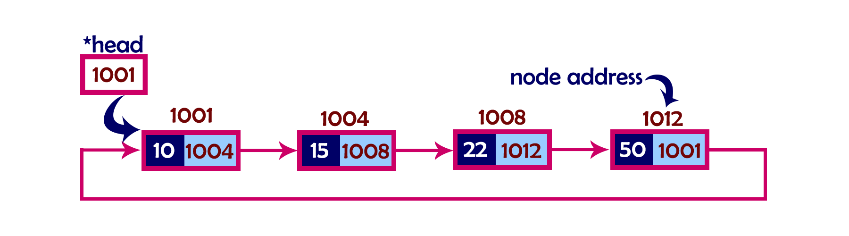
Circular Linked List
A circular linked list is a list where each node has two parts; one is data part to hold the data and another is pointer part that points the next node and
the last node’s pointer points the first node of the list.
And there is an external pointer to the list that points the first node.

Slide 57
Circular Linked List [contd.]
List
Figure 4.9: Pictorial view of a circular linked list (a circular diagram)

Slide 58
Create a circular linked list
Creation process of a circular linked list is similar to the creation process of a linear linked list which is already discussed.
Here we have to make link between the last node and the first node which will create a circle (linked list as a circle).

Slide 59
Create a circular linked list (Graphical view)
List
List
1
List
NULL
40
40
2
40
nptr
3
nptr
tptr
tptr
(i) An empty list
(ii) A new node
(iii) Making link
  (iv) A circular linked list with one node
Figure 4.11: Linking process of the first node of a circular linked list

Slide 60
Create a circular linked list [contd.]
List
List
40
63
40
1
63
2
tptr
nptr
tptr
nptr
tptr
3. Forward tptr
  (i) A circular list with one node
(ii) A new node
  (iii) Making link between last node & new node, new node & first node.
List
(delete)
40
63
2
tptr
  (iv) Updated circular linked list after making link.
Figure 4.12: Creation of a circular linked list with more than one node

Slide 61
Algorithm to create a circular linked list (pseudocode)
1. Declare node and pointers (list, tptr, nptr)
2. Create an empty inked list
list = NULL;
3. Create a new node with data:
nptr = new (node);
nptr→data = item;
nptr→next = NULL;
4. Make link between new node and the link list:
if (list = NULL)
{
list = nptr;
nptr→next = list; //for circular link
tptr = nptr;
}
else
{
tptr→next = nptr;
nptr→next = list; //Circular link
tptr = nptr;
}
5. Output a circular linked
list.

Slide 62
Difference between array and linked list
An array is a finite set of same type of data items (elements). In other words, it is a collection of homogeneous data items. The elements of an array are stored in successive memory locations. Any element of an array is referred by array name and index number (subscript).
Whereas, linked list is a list or collection of data items stored in scattered memory locations. Each data item has two parts. One is data part and another is link (pointer) part. Each data item of a linked list is called node. Data part holds actual data (information) and the link part points to the next node of the list. To locate the list or the 1st node of the list, an external pointer is used. The link part of the last node will not point any node. That means it will be null.

Slide 63
Difference between array and linked list [contd.]
2. Array implementation depends on size and it results in wastage of memory space. On the other hand, linked list does not depend on size.
3. Types of array are one dimensional, two dimensional etc. and types of linked list are linear, doubly, circular etc.
4. An element of an array can be accessed directly and access time is fixed as well as efficient. On the other hand, a node of a linked list can not be accessed directly and access time is linear and not so efficient.
5. Array is a static data structure and a linked list is a dynamic data structure.

Slide 64
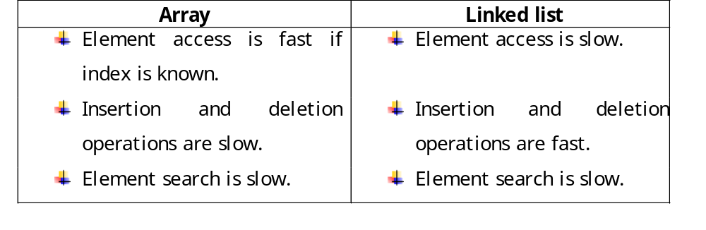
Comparison of operations using array and linked list.

Slide 65
This is the end of linked list
THANK YOU.

